Slide 1

D
a
a
t
SLC 2021 Crime Data Analysis
Camille Floyd Fridencio Loza Yao Li
Group
s
s

Slide 2





Data Source
OpenWeather API
FBI's Uniform Crime Reporting (UCR) program
U.S. Census Bureau
Group

Slide 3
Statistical Modeling Techniques
Linear regression
Time series analysis
Generalized linear model
Clustering
Group

Slide 4
Group

Slide 5
Group

Slide 6

Weather
Why should weather be a factor?
According to studies on healthline.com and webmd.com. Rainy days and winter months can influence negative emotions including depression and irritability.
During winter months where days are shorter and human contact is less frequent, this will only add to negative emotions for certain individuals.
The purpose of this factor is to see if there are periods of the year where certain crimes are more susceptible.
https://www.healthline.com/health/mental-health/weather-and-mood#risk-factors, https://www.webmd.com/balance/features/can-rainy-days-really-get-you-down,
Group

Slide 7
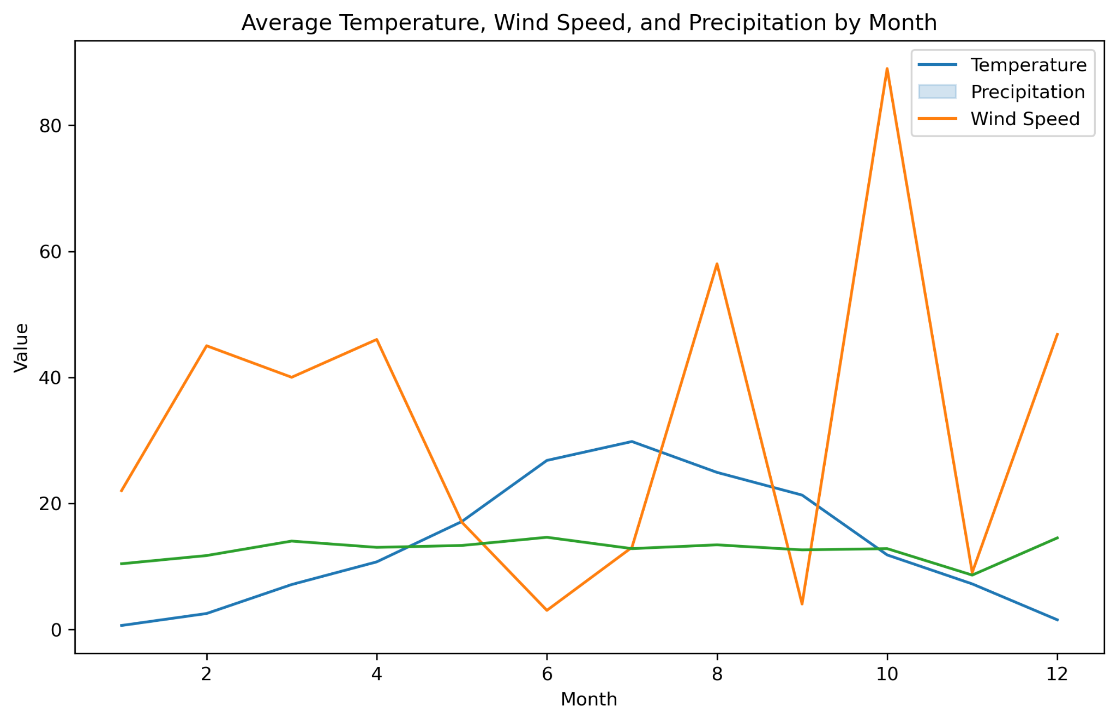
The timeframe shows that during the colder months wind, precipitation and temperature change drastically compared to the more favorable months of the year.
Group

Slide 8
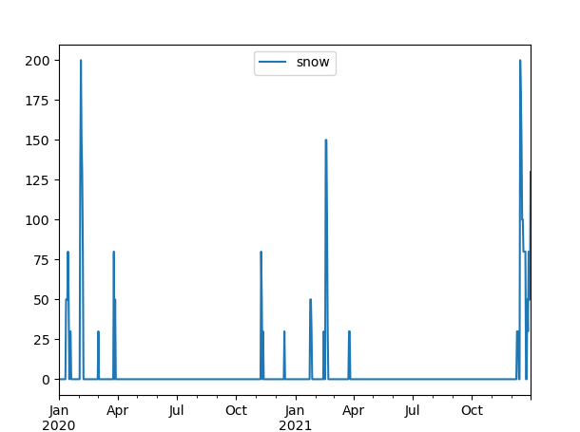
In the first winter months of 2020 compared to the First winter months of 2021, there were higher snow accumulations during the infamous “COVID” year.
Group

Slide 9
What do we learn from the data collected?
Without looking at the other two data sets, we can hypothesize that with drastic weather patterns in winter months can potentially cause people to be more depressed, anxious and irritable. However, the other side of the coin is that with more favorable weather, the ideal conditions are met for criminal activity that require more frequent social activities.
Let’s consider the next two factors: Crime Trends and Demographics.
Group

Slide 10
Group

Slide 11
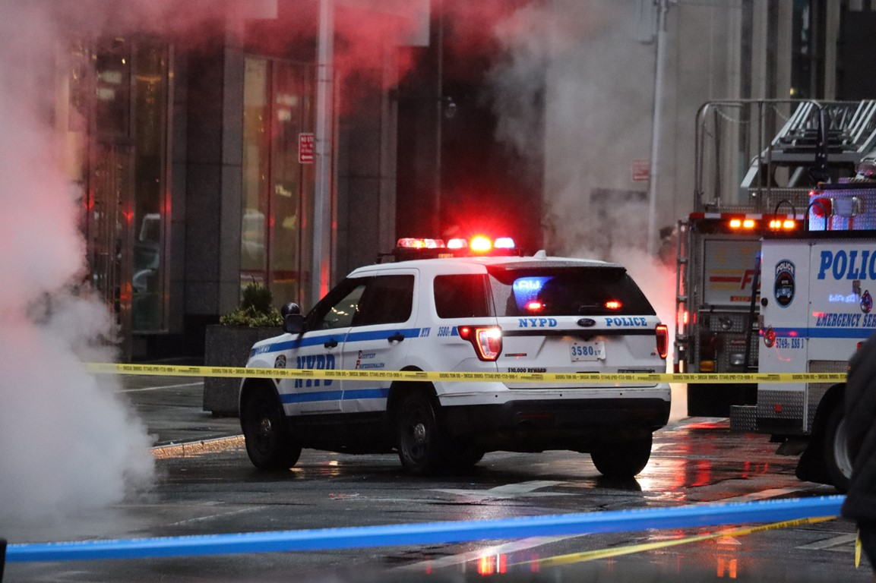
Crime
The analysis found that the mean crime rate for each city in 2021 was as follows:
NORTH SALT LAKE: 7773.67
SALT LAKE CITY: 52861.82
SALT LAKE CNTY UNIFD PD: 3396.26
SOUTH SALT LAKE: 4489.46
Group

Slide 12
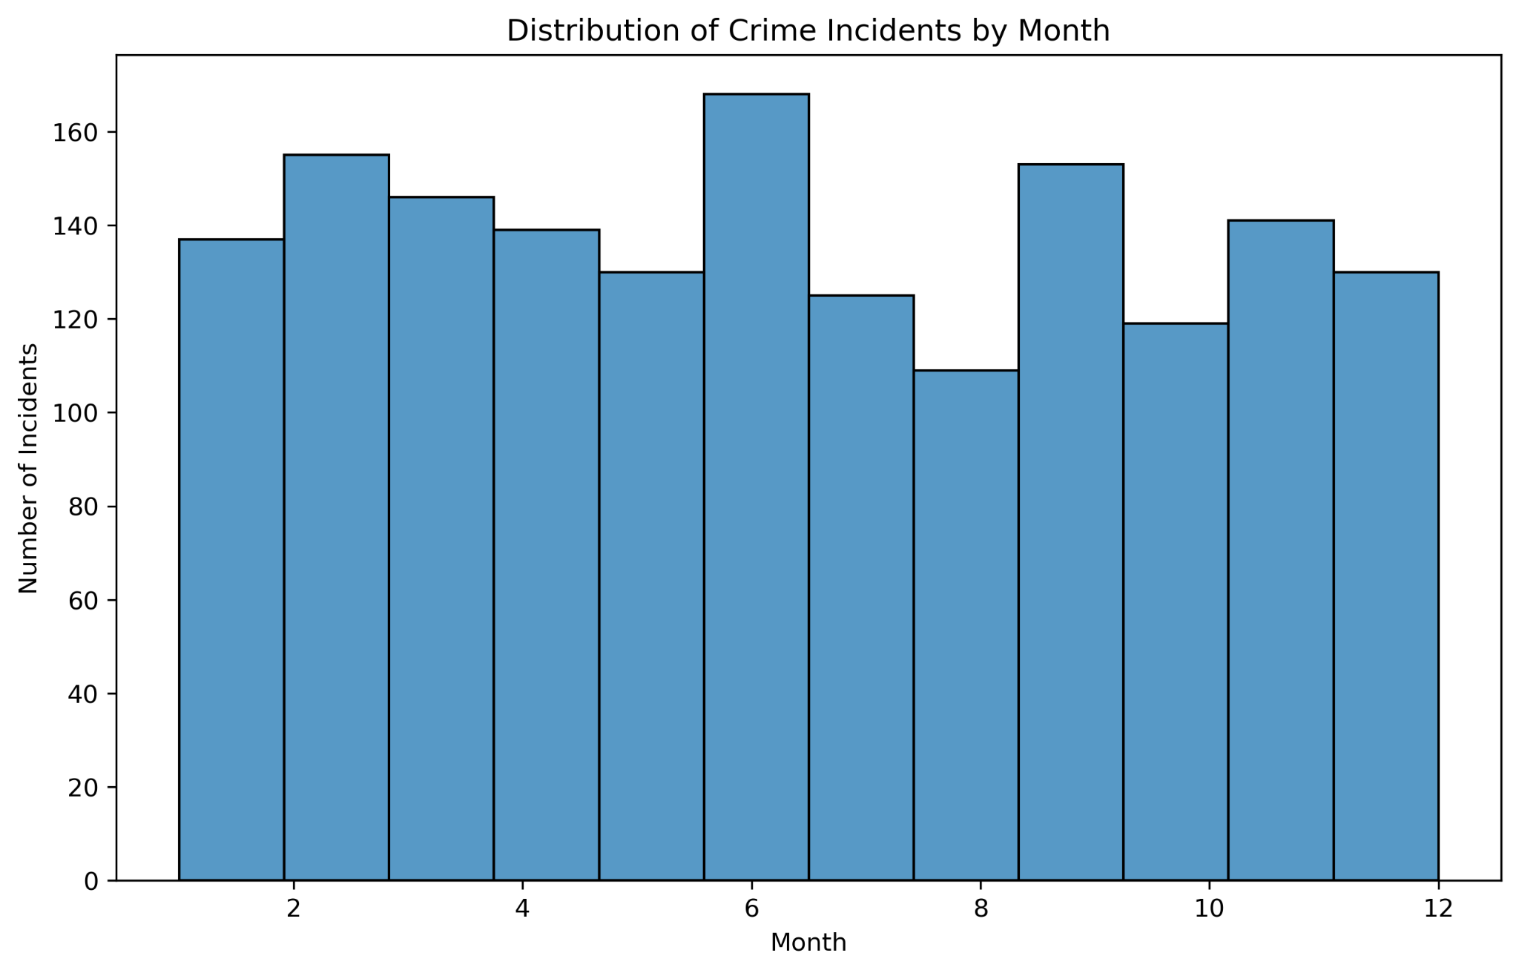
Crime incidents were highest during the summer months and lowest during the winter months.
Group

Slide 13
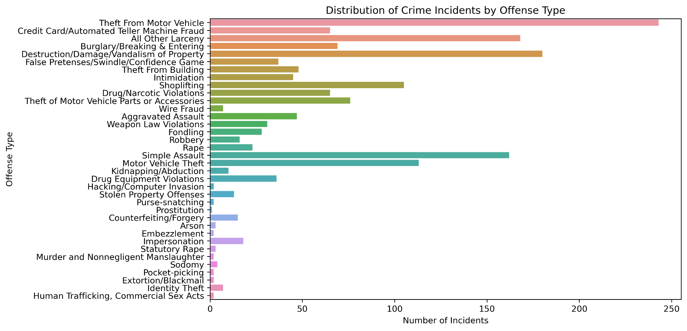
Group

Slide 14
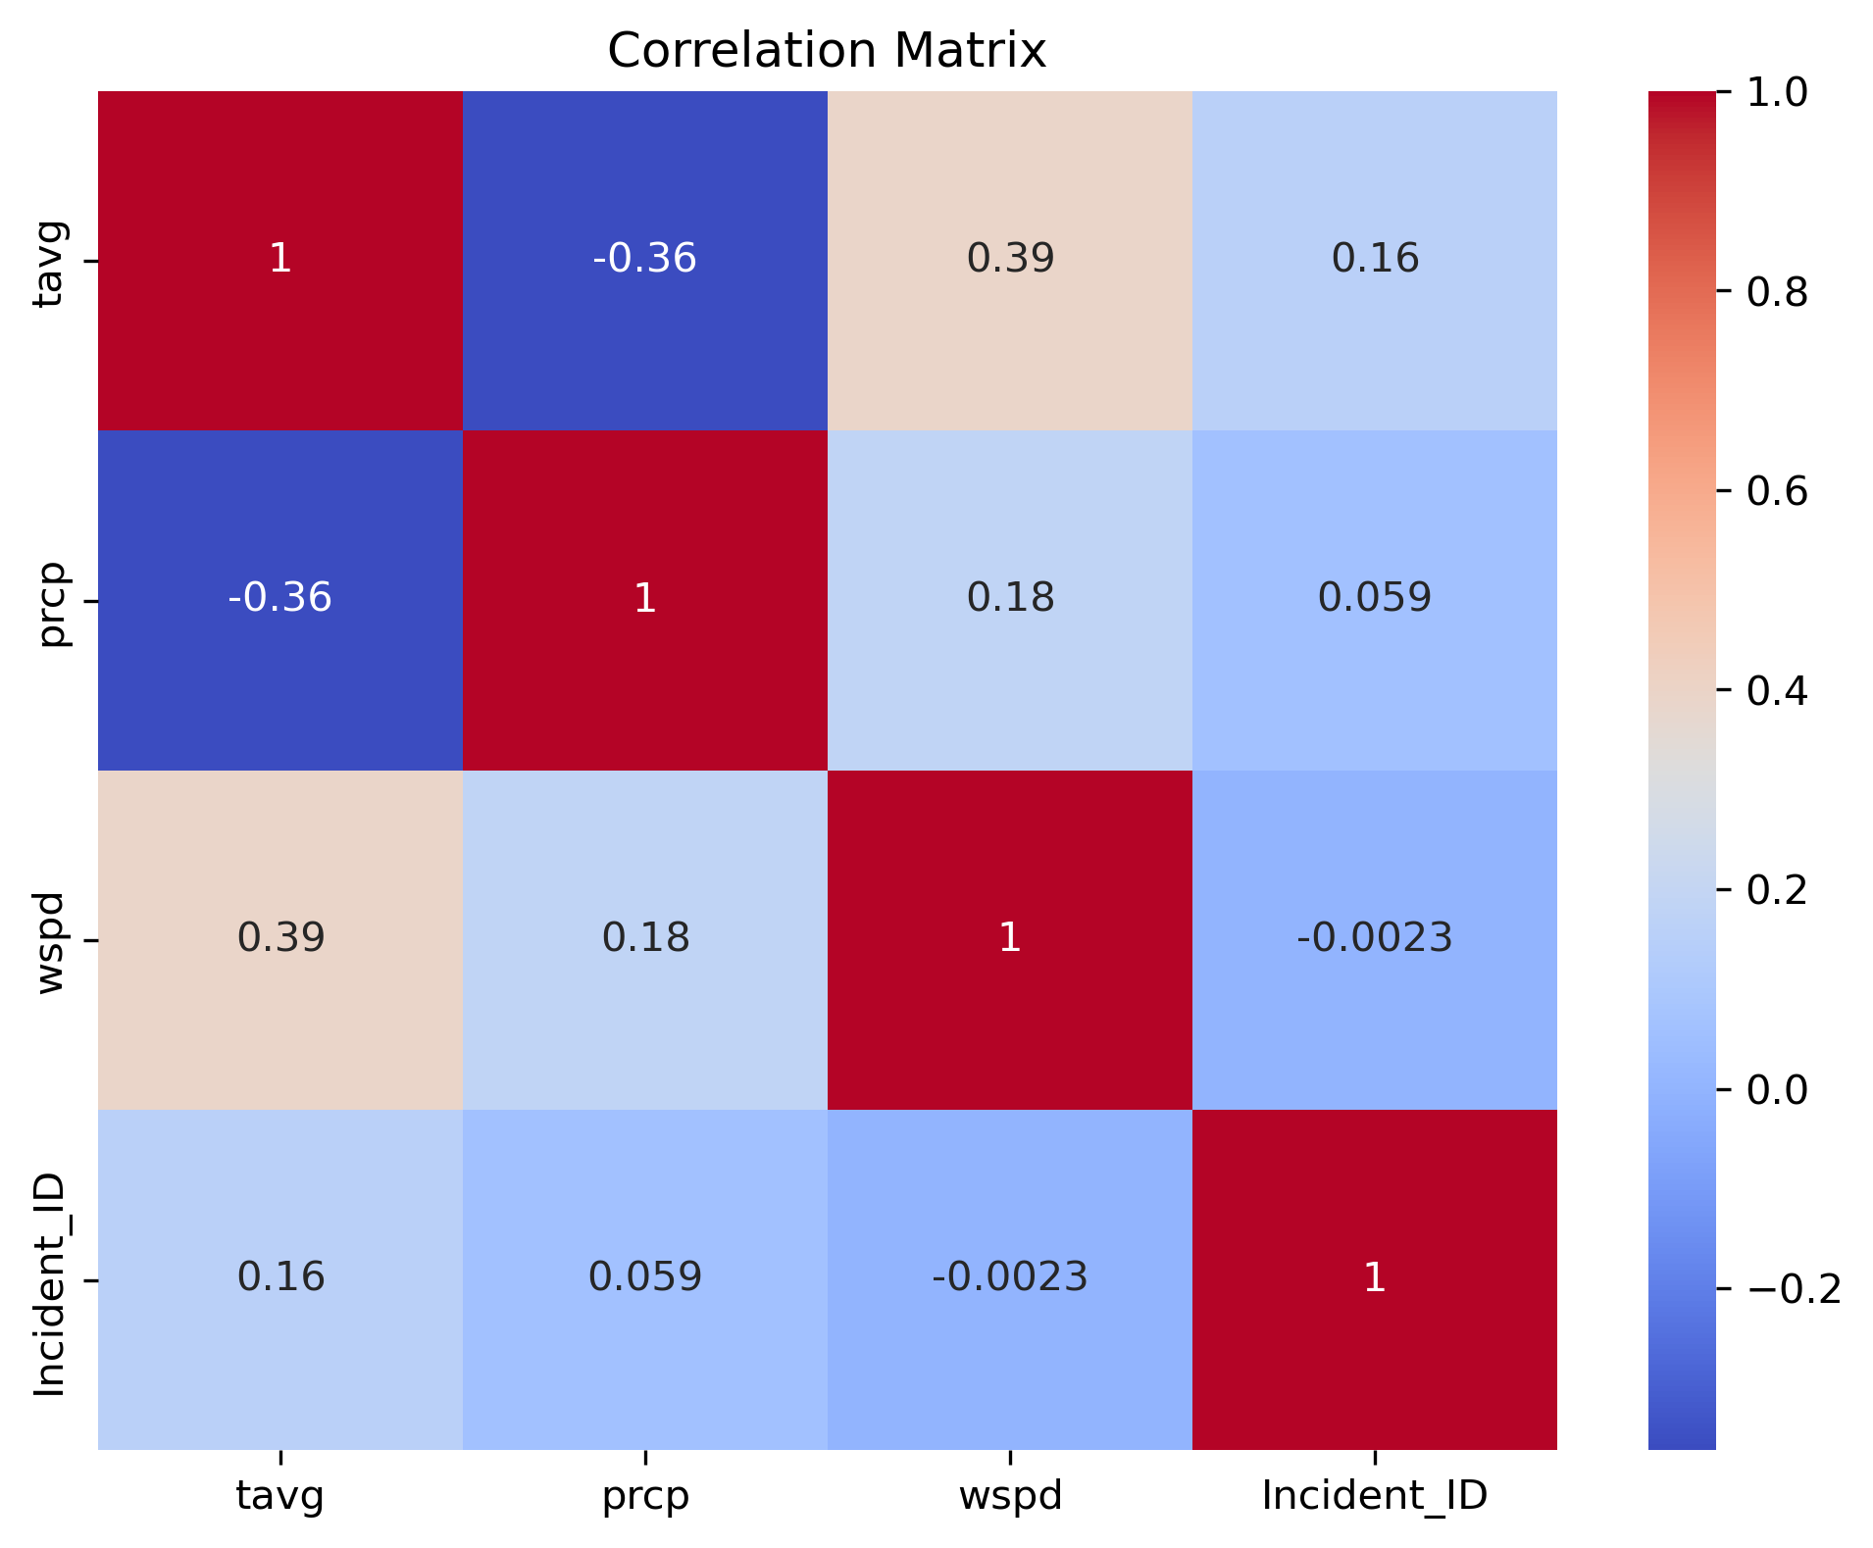
Correlation matrix
the correlation matrix between the variables showed a weak positive correlation between temperature and incident ID.
temperature, precipitation, wind speed, and incident ID
Group

Slide 15
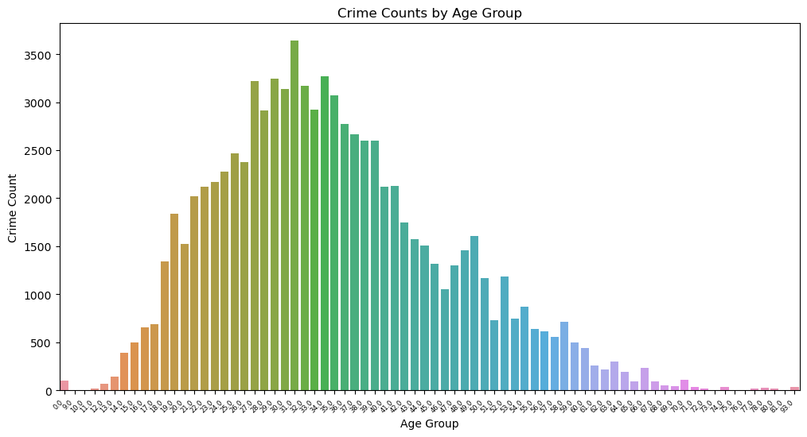
Group

Slide 16

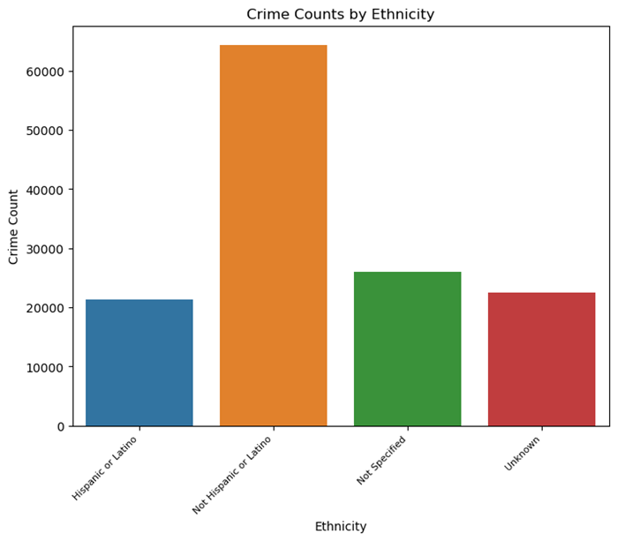
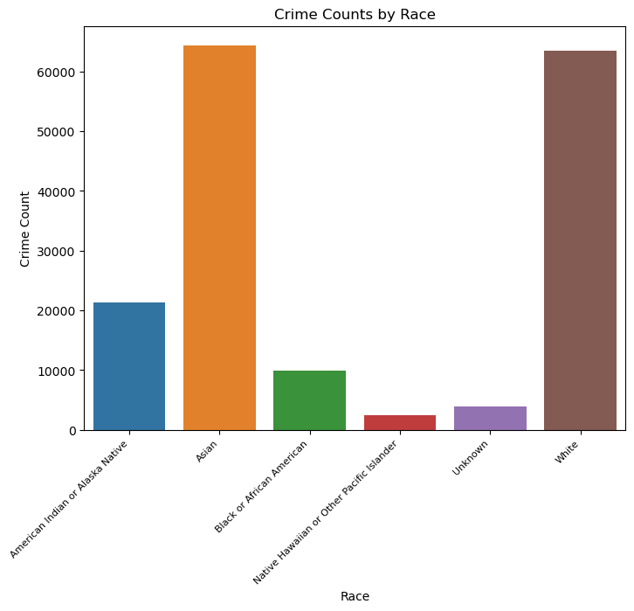
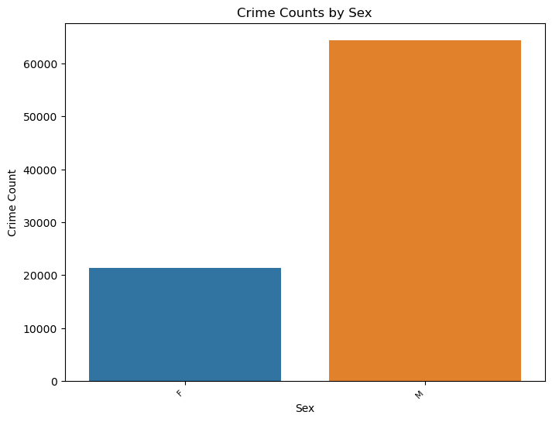
Group

Slide 17
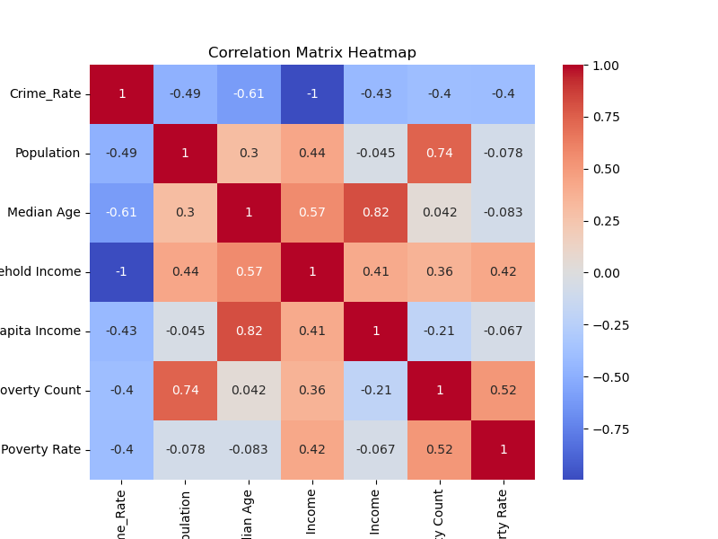
The heatmap shows strong positive correlations between population and crime rate.
It also shows a weak negative correlation between median age and crime rate.
Group

Slide 18
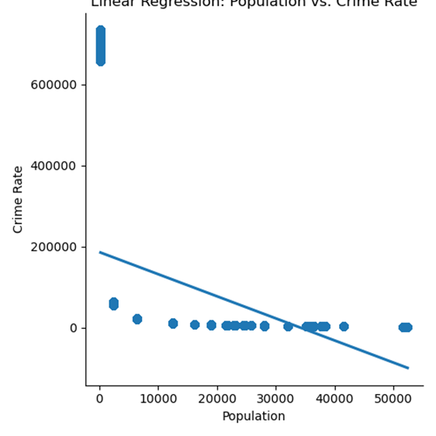
Group

Slide 19
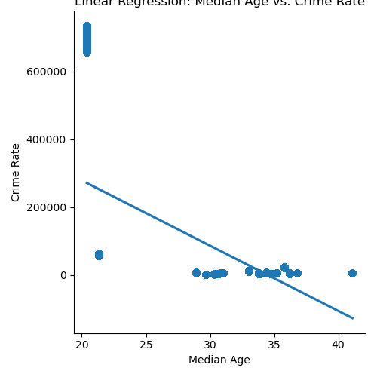
Group

Slide 20
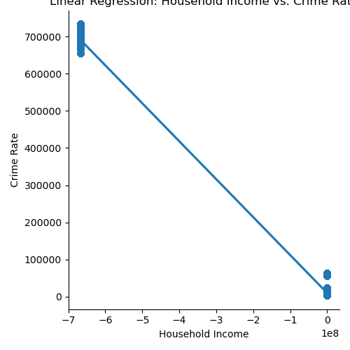
Group

Slide 21
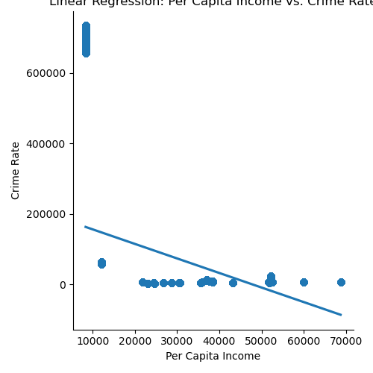
Group

Slide 22
Group

Slide 23
Group

Slide 24
Group

Slide 25
Group

Slide 26
Group

Slide 27
Group

Slide 28
Group

Slide 29
Group

Slide 30
Group

Slide 31
Group

Slide 32
Group

Slide 33
Group

